Slide 1
Unit 5 Tree

Slide 2
REPRESENTING BINARY TREES IN MEMORY
Linked representation
Array representation

Slide 3
Linked Representation of Binary Trees
Each node N of T will correspond to a location K such that:
INFO[K] contains the data at the node N.
LEFT[K] contains the location of the left child of node N.
(3) RIGHT[K] contains the location of the right child of node N.
ROOT will contain the location of the root R of T.

Slide 4
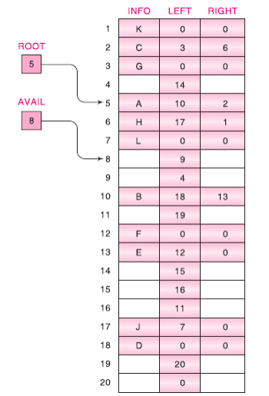
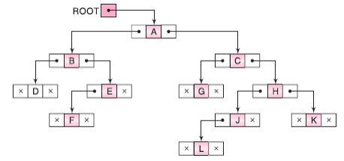
Linked Representation of Binary Trees

Slide 5
Sequential Representation of Binary Trees
This representation uses only a single linear array TREE as follows:
The root R of T is stored in TREE[1].
(b) If a node N occupies TREE[K], then its left child is stored in TREE[2 * K] and its right child is stored in TREE[2 * K + 1].

Slide 6
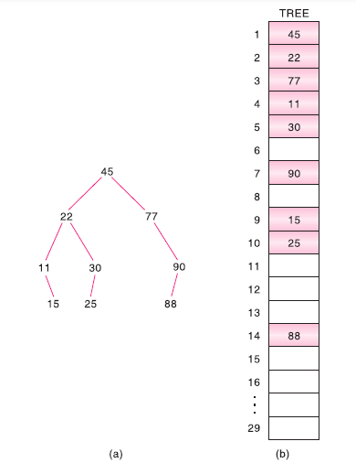
Sequential Representation of Binary Trees

Slide 7
TRAVERSING BINARY TREES
Preorder
Process the root R.
Traverse the left subtree of R in preorder.
Traverse the right subtree of R in preorder.
Inorder
(1) Traverse the left subtree of R in inorder.
(2) Process the root R.
(3) Traverse the right subtree of R in inorder.
Postorder
Traverse the left subtree of R in postorder.
Traverse the right subtree of R in postorder.
Process the root R.

Slide 8
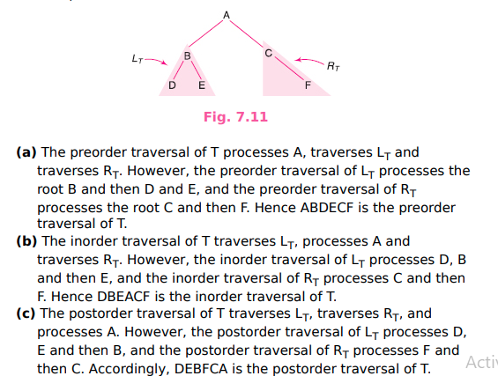
Example

Slide 9
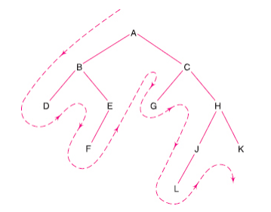

Example

Slide 10
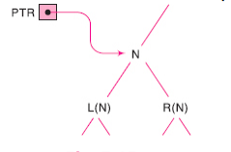
Preorder Traversal
variable PTR (pointer) : contain the location of the node N currently being scanned
L(N) denotes the left child of node N and
R(N) denotes the right child.
STACK, which will hold the addresses of nodes for future processing.

Slide 11
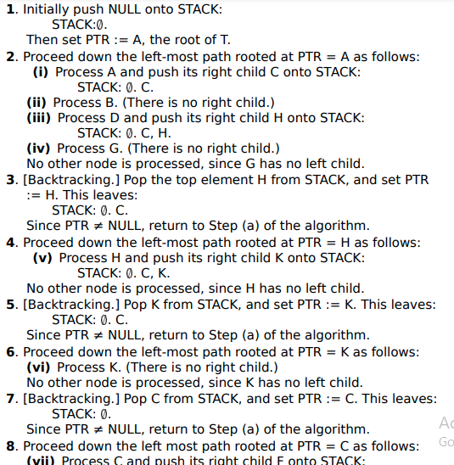
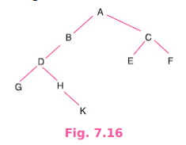
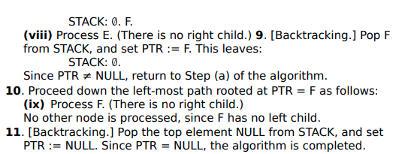
Preorder Traversal
Algorithm: Initially push NULL onto STACK and then set PTR := ROOT.
Then repeat the following steps until PTR = NULL or, equivalently, while PTR ≠ NULL.
(a) Proceed down the left-most path rooted at PTR, processing each node N on the path and pushing each right child R(N), if any, onto STACK. The traversing ends after a node N with no left child L(N) is processed. (Thus PTR is updated using the assignment PTR := LEFT[PTR], and the traversing stops when LEFT[PTR] = NULL.)
(b) [Backtracking.] Pop and assign to PTR the top element on STACK. If PTR ≠ NULL, then return to Step (a); otherwise Exit. (We note that the initial element NULL on STACK is used as a sentinel.)

Slide 12
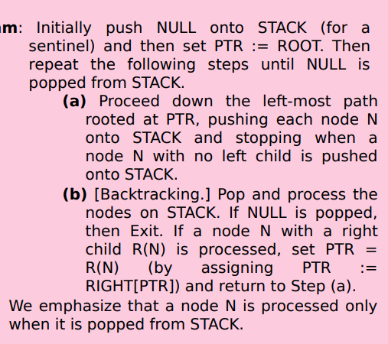
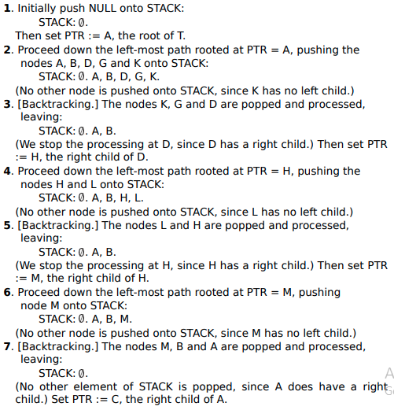
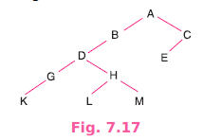
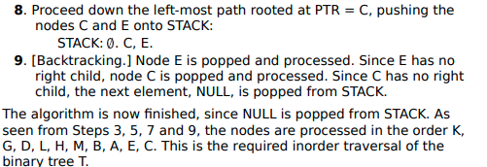
Inorder Traversal

Slide 13
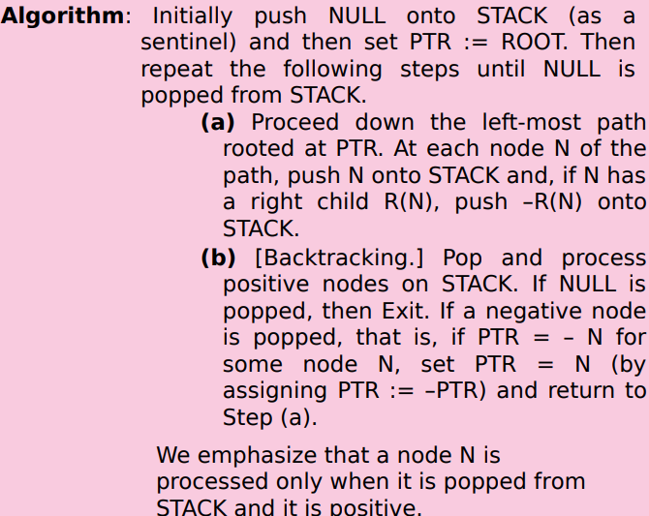
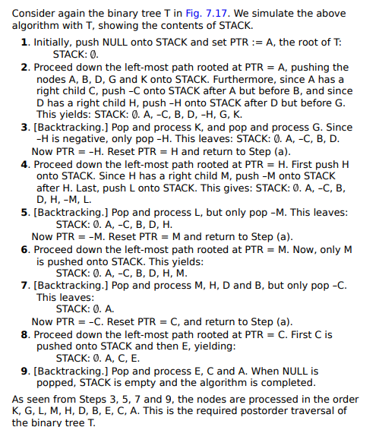
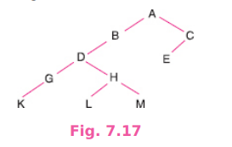
Post Order Traversal

Slide 15
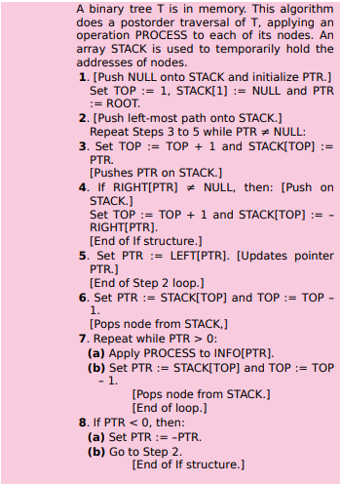

Slide 16
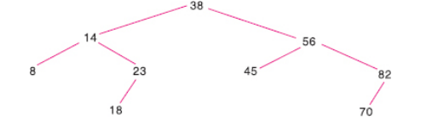
Binary Search Tree (BST)
Average running time- O(log2 n)
Structures
Sorted array
Linked List
Definition:
Suppose T is binary tree. Then T is called a binary search tree (or binary sorted tree) if each node N of T has the following property: The value of N is greater than every value in the left subtree of N and is less than every value in the right subtree of N.
Example:

Slide 17
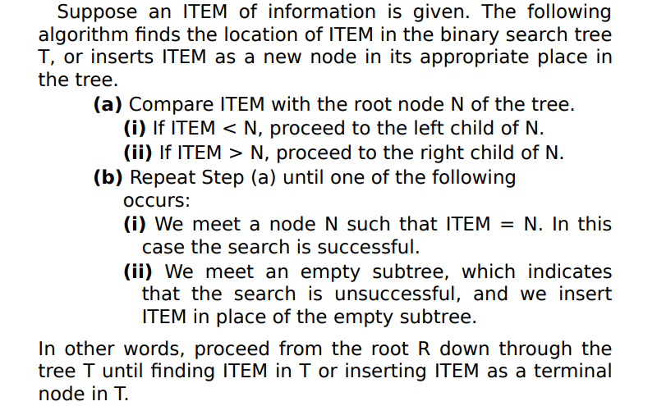
Searching and Inserting in Binary Search Tree

Slide 18
Example
Item=20

Slide 19

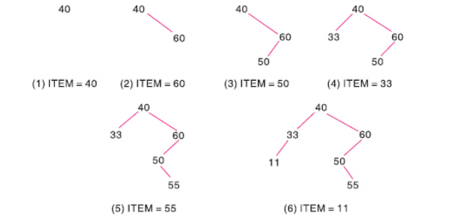

Slide 20
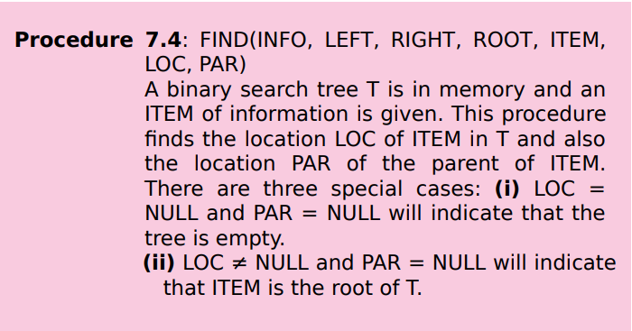
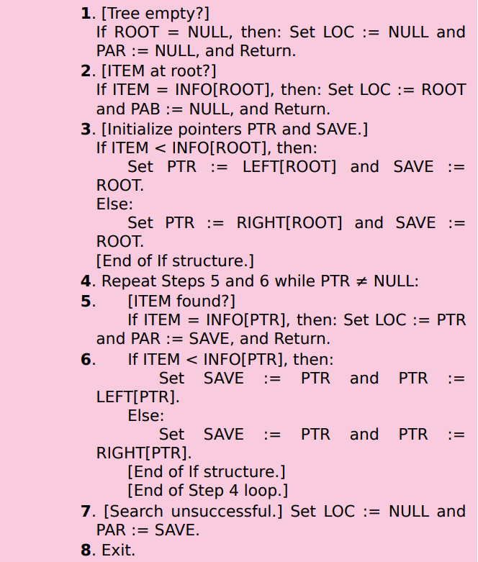

Slide 21
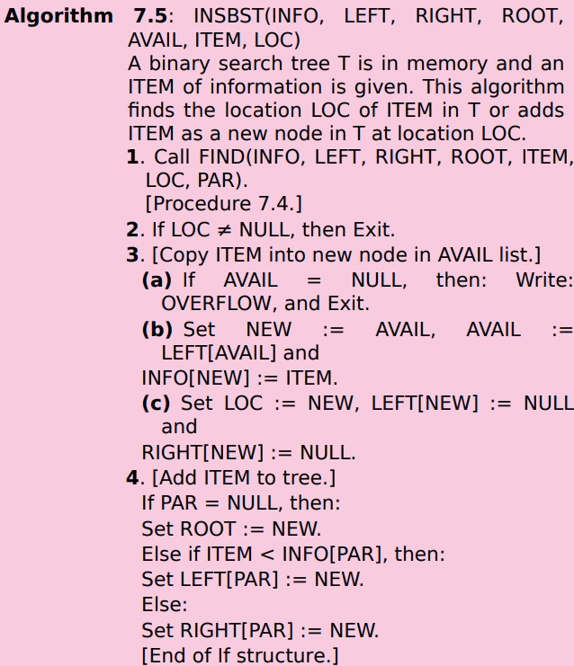

Slide 22
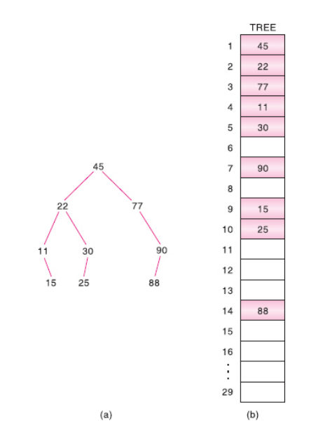

Slide 23
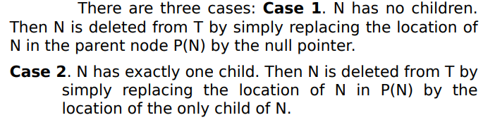
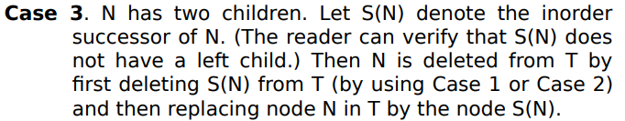
Deleting in a Binary Search Tree

Slide 24
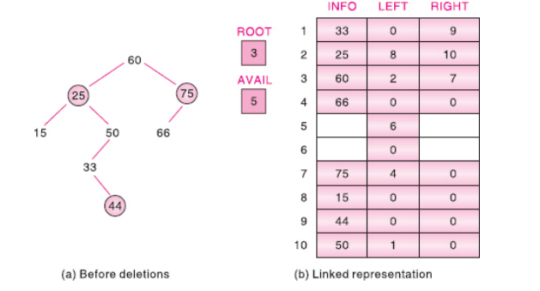
Case A

Slide 25
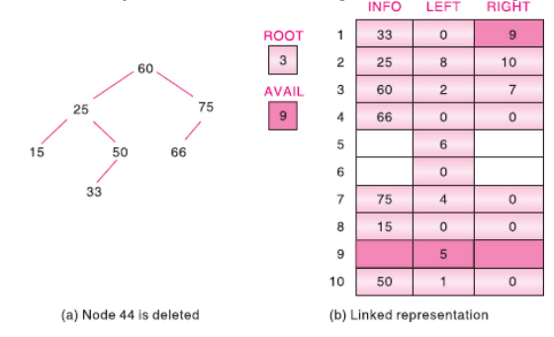
Case B

Slide 26
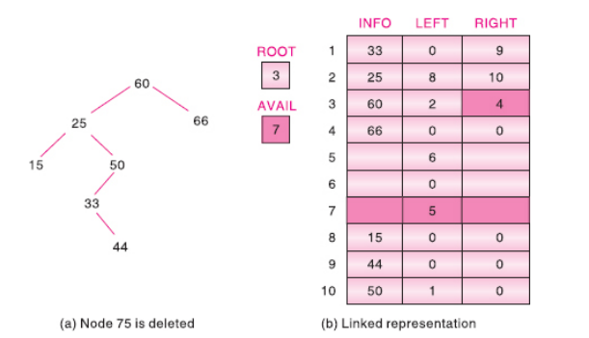
Case C

Slide 27
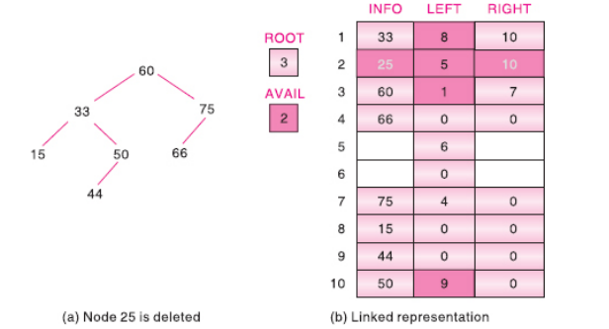

Slide 28
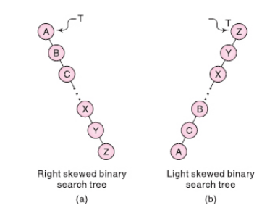
AVL tree

Slide 29
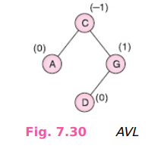
Representation of an AVL Searc

Slide 30
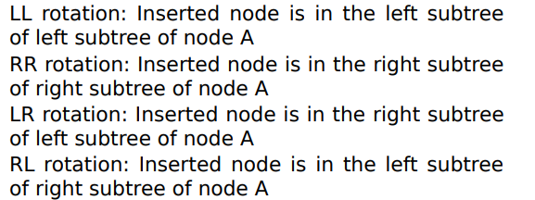
Insertion in an AVL search tree

Slide 31
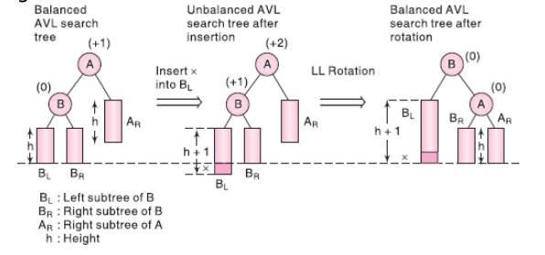
LL Rotation

Slide 32
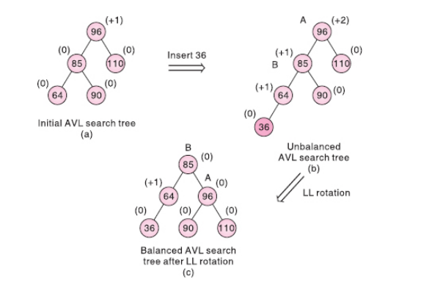
Example

Slide 33
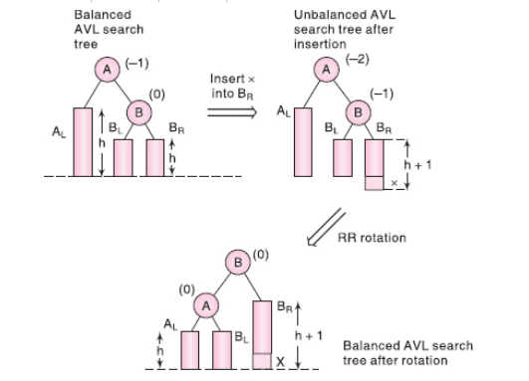
RR Rotation

Slide 34
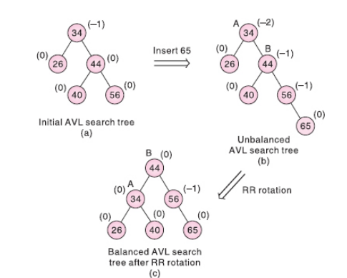
Example

Slide 35
Heap
Maxheap
Minheap

Slide 36
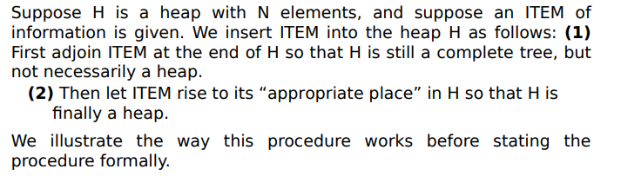
Inserting into a Heap

Slide 37
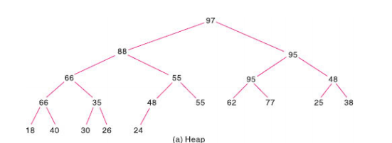
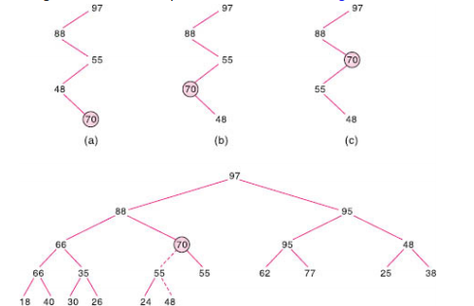
Example

Slide 38
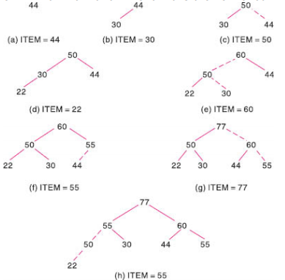
Example

Slide 39
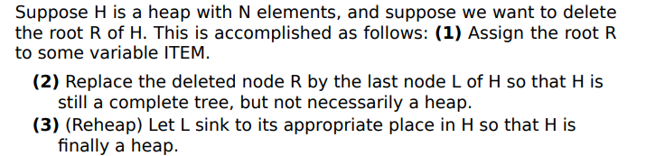
Deleting the root of Heap

Slide 40
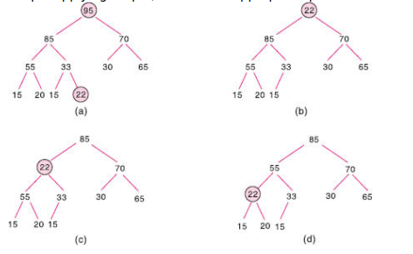
Reheaping

